Slide 1
Access the slides and files here:
https://github.com/j-berg/bioinformatics_bootcamp

Slide 2
#4.2
Complex tasks
Performance
Debugging

Slide 3
Questions from writing a script?

Slide 4
Performance
https://towardsdatascience.com/understanding-time-complexity-with-python-examples-2bda6e8158a7

Slide 5
Linear Time
for x in my_list:
if x == 100000:
print(“I’m here”)
break
Best case: item is at beginning of the list
Worst case: item is at the end of the list

Slide 6
Constant Time
if x == y: print(“True”) else: print(“False”)
if value in my_set:
print(“True”)
Not dependent on the input

Slide 7
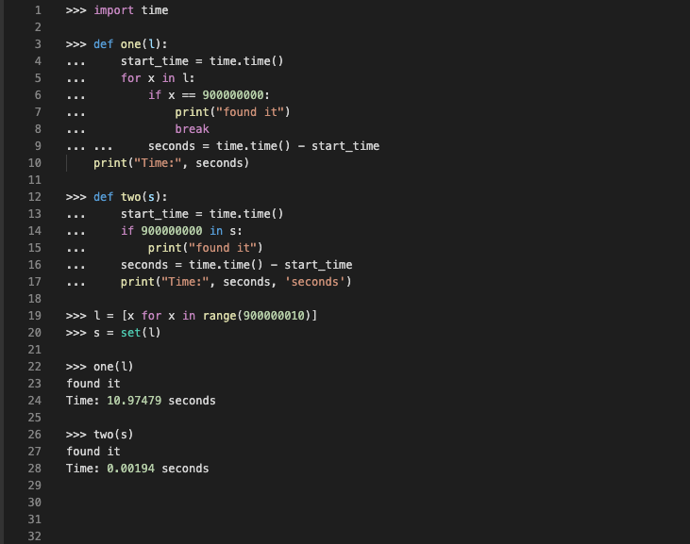

Slide 8
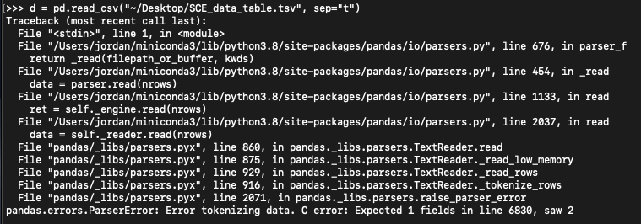
Troubleshooting

Slide 9
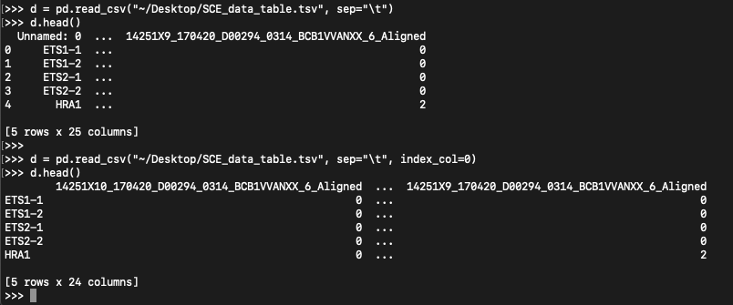
Troubleshooting

Slide 10
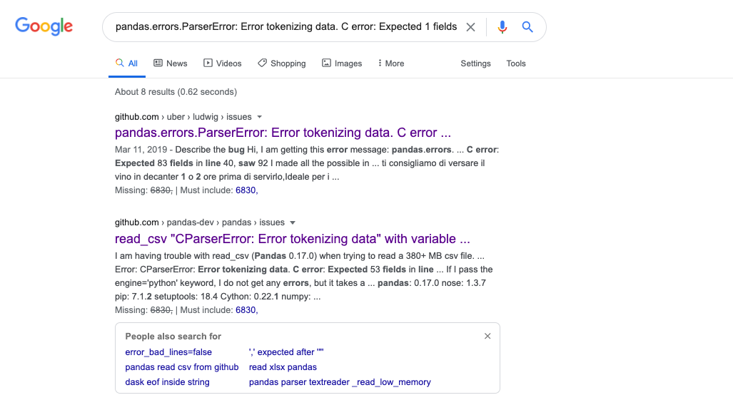
Copy the most informational error line

Slide 11
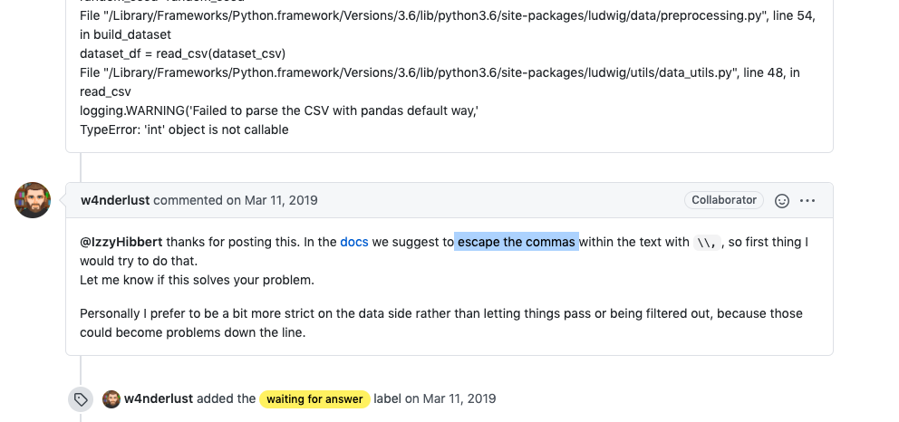
Not an exact answer, but we can work with it

Slide 12
Troubleshooting

Slide 13
Troubleshooting

Slide 14
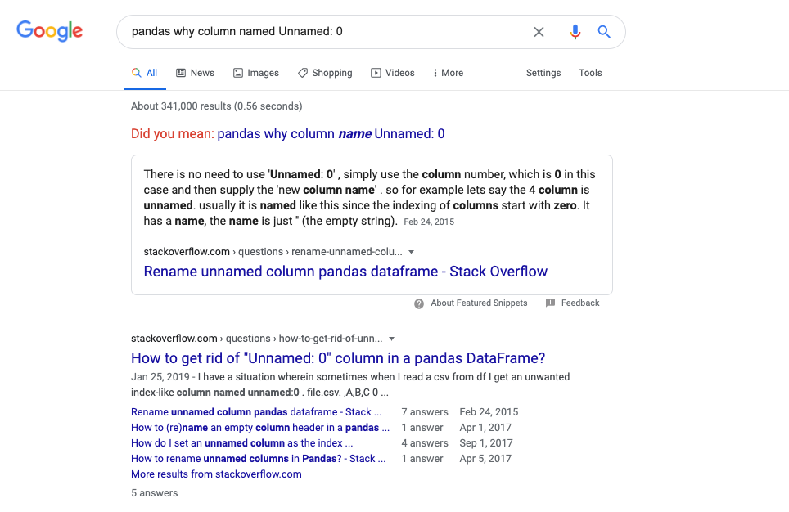
Learn to describe the problem to Google

Slide 15
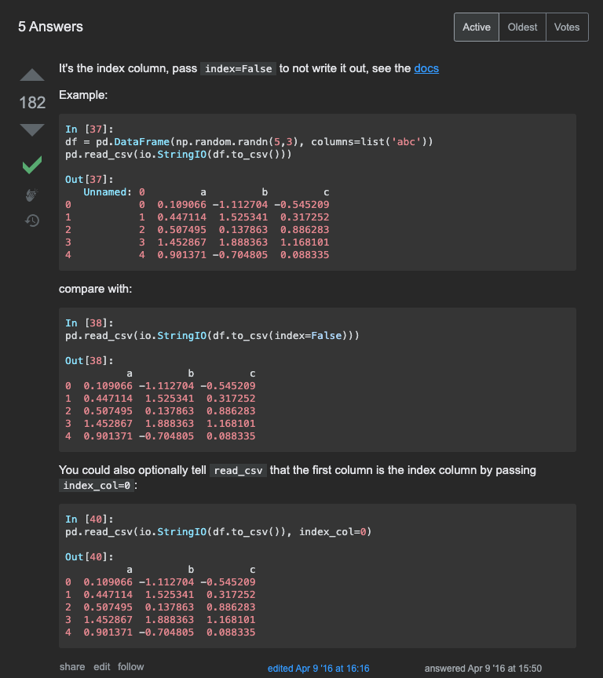
Again, not an exact answer, but we can work with it

Slide 16
Again, not an exact answer, but we can work with it

Slide 17
Homework
Review concepts from Python classes
Finish gene dictionary project

